Slide 1
Convective Heat Transfer in High Aspect Ratio Cavities – Numerical Study

Slide 2
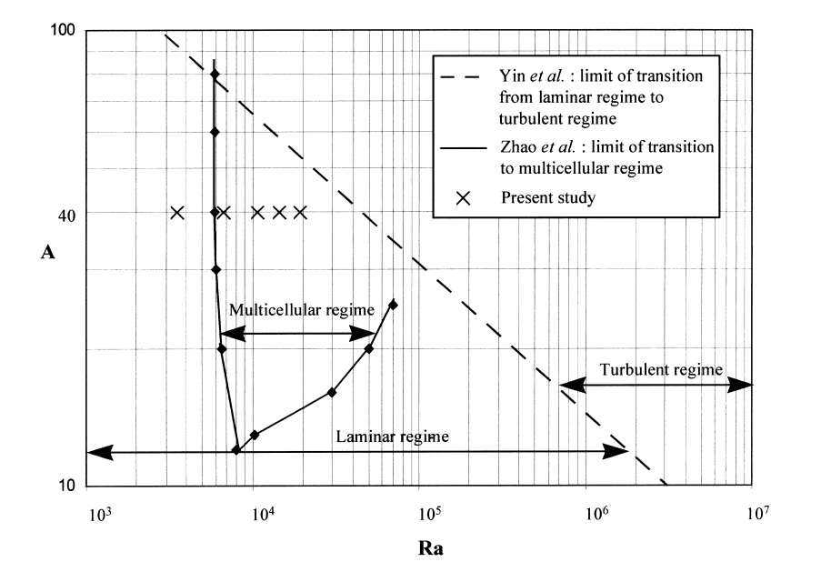
Introduction and Motivation
Secondary flows in high aspect ratio, vertical cavities, in laminar regime
Practical application includes – insulated glazing units (IGU)
Fluid movement inside the cavity is due to Buoyancy resulting from temperature difference between both vertical surfaces
The flow exhibits two states:-
Laminar and unicellular
Multicellular with increased local and average heat transfer coefficients
Solution is the function of three dimensionless parameters:-
Aspect Ratio of cavity (A)
Prandtl number of fluid (Pr)
Rayleigh number (Ra)
Ref: B. Lartigue, S. Lorente, B. Bourret, Multicellular natural convection in a high aspect ratio cavity: experimental and numerical results, International Journal of Heat and Mass Transfer 43 (2000) 3157-3170

Slide 3
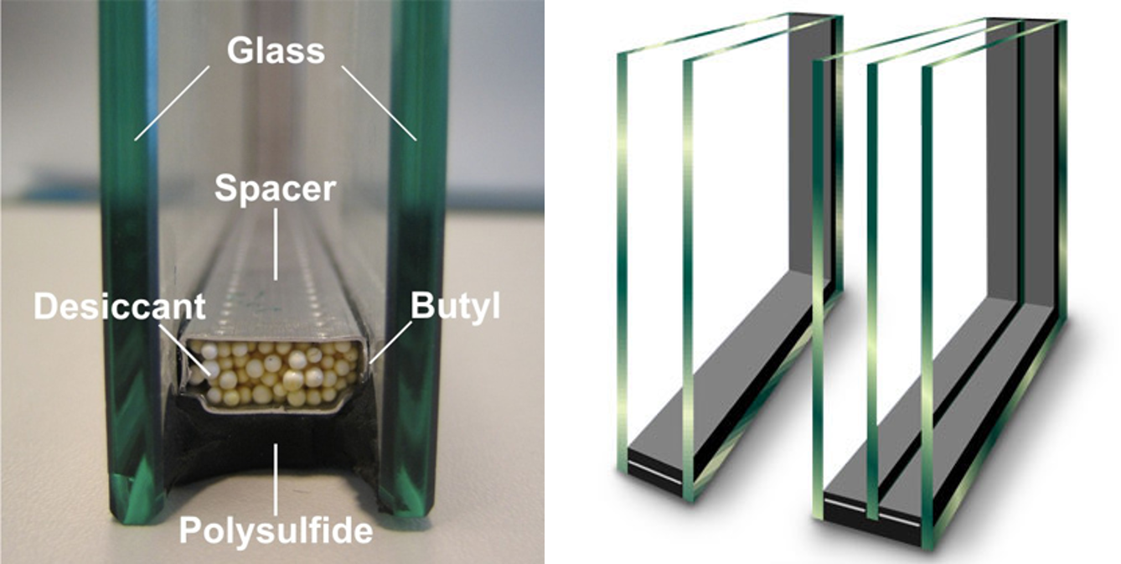
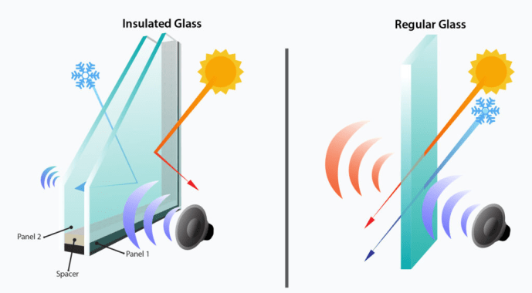
IGUs
An insulated glass unit (IGU) consists of multiple glass panes separated by air or a noble gas-filled cavity that reduces heat transfer and provides building insulation.
Insulated glass significantly regulates the indoor temperature and acts as a barrier to unwanted heat and noise.
Heat transfer has been found to be a function of fluid Pr #, Rayleigh # and aspect ratio of the cavity.

Slide 4
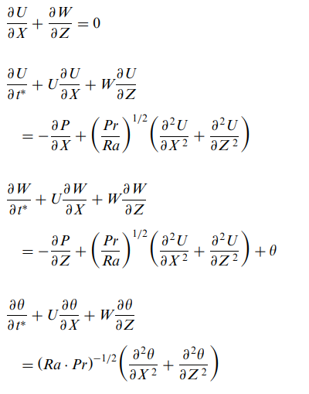
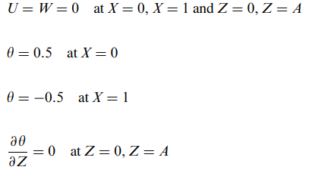

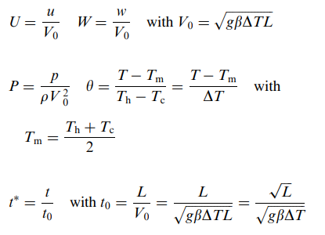
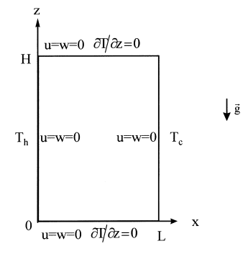
Numerical Methodology
N-S equations in Dimensionless Form
Dimensionless Variables
Boundary Conditions

Slide 5
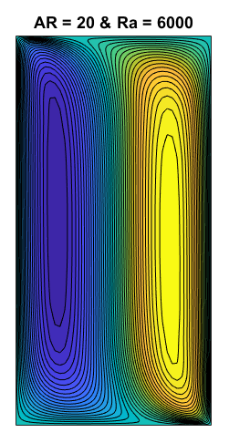
Numerical Results
Ra = 6000 & AR = 20
V Velocity Contours
Temp Profile
V Vel Profile
U Vel Profile

Slide 6
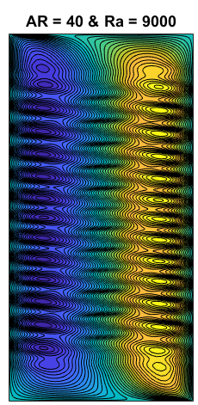
Numerical Results
Ra = 9000 & AR = 40
V Velocity Contours
Temp Profile
v Vel Profile
u Vel Profile

Slide 7
Evolution of local Nusselt number (Nu)

Slide 8
Evolution of local Nusselt number (Nu)

Slide 9
Evolution of local Nusselt number (Nu)

Slide 10
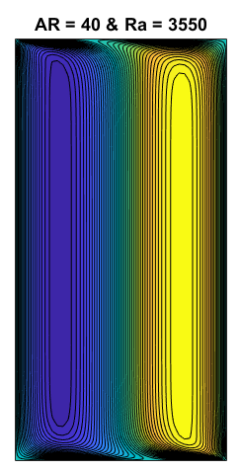
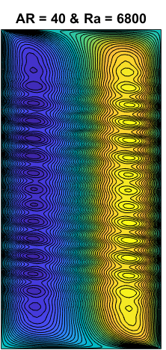
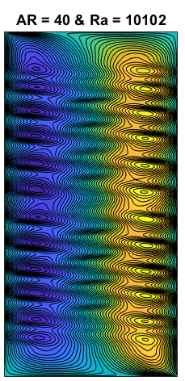
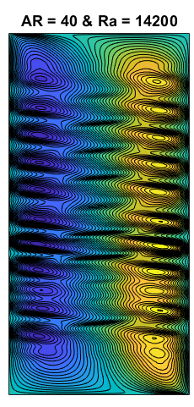
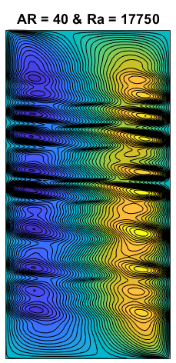
Validation & Verification
Avg Nu Number – Numerical Results
Ra | Numerical Results (Current study) | B. Lartigue et al. | Zhao et al. | Wright et al. | Lee et al | ElSherbiny et al. (Experimental)
3550 | 1.091 | 1.064 | 1.063 | Not available | 1.05 | 1.009
6800 | 1.1773 | 1.167 | 1.158 | 1.15 | Not available | 1.096
10,102 | 1.2922 | 1.292 | 1.277 | 1.28 | Not available | 1.244
14,200 | 1.4353 | 1.388 | 1.399 | Not available | 1.38 | 1.417
17,750 | 1.4573 | 1.484 | 1.487 | Not available | 1.46 | 1.549

Slide 11
Analysis
For Rayleigh number equal < 3550, the flow is in the conduction regime.
For Rayleigh number > 6000, the flow becomes multicellular.
For Ra = 6800, the local Nusselt number tends to oscillate on a regular way around the value corresponding to the conduction regime.
When the value of Rayleigh number increases further, the regularity of the oscillations is destroyed, and the multicellular laminar flow being fully established, before becoming turbulent.
The number of cells on onset of multicellular flow decreases as the Rayleigh number increases.
Results of Numerical study found in agreement with the previous studies/ experimental results.
The turbulent regime at AR=40 is categorized at Ra=40,000.
Up to a value of 6000, the energy transfer from the hot face towards the cold face is carried out directly by conduction.
If the Rayleigh number increases, conduction is not enough any more to ensure the transfer of necessary heat.
The development of a secondary flow (secondary cells) has the role to mitigate this deficit, allowing heat transfer by convection.
The results obtained tends to show that these ordered structures occur starting in the top of the cavity. After having traversed the cavity core, each structure comes in the bottom, to be connected to the primary flow.
If the Rayleigh number increases further, these structures lose their ordered character and the flow enters the turbulent mode.

Slide 12
Conclusion
The code solves N.S equation (continuity, momentum and energy equations) for high aspect ratio vertical cavity flows.
The numerical scheme successfully identifies the unicellular and multicellular flows at different aspect ratios and Ra numbers.
The results obtained are in agreement to the available experimental/ numerical results from literature.

Slide 13
THANK YOU

